Slide 1


UnderStand Autism
Community Club for Children and their Families and Friends
by Marlena Boltruczuk

Slide 2
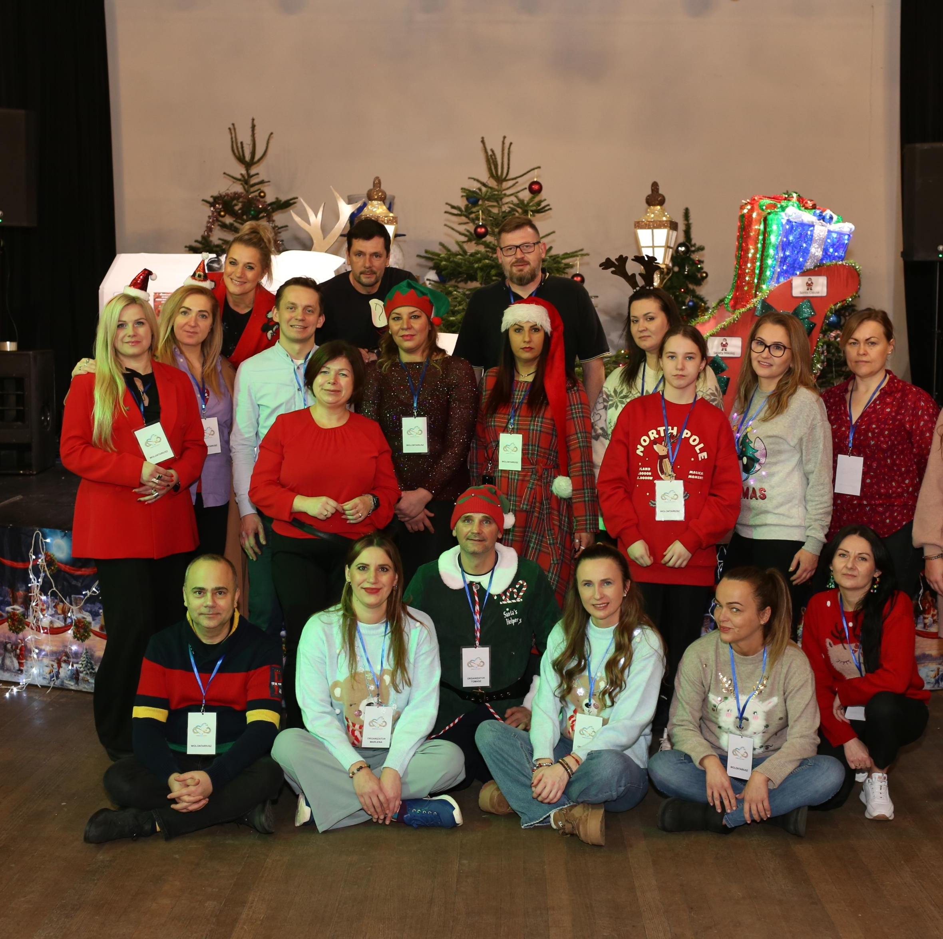
About Us!
Understand Autism is an initiative created to support children with autism and their families. We provide a space for growth, education, and integration.
Our team consists of passionate and experienced individuals who work with children with various disabilities.
We operate locally in London, supporting Polish families in their daily challenges and helping them find the assistance they need.

Slide 3
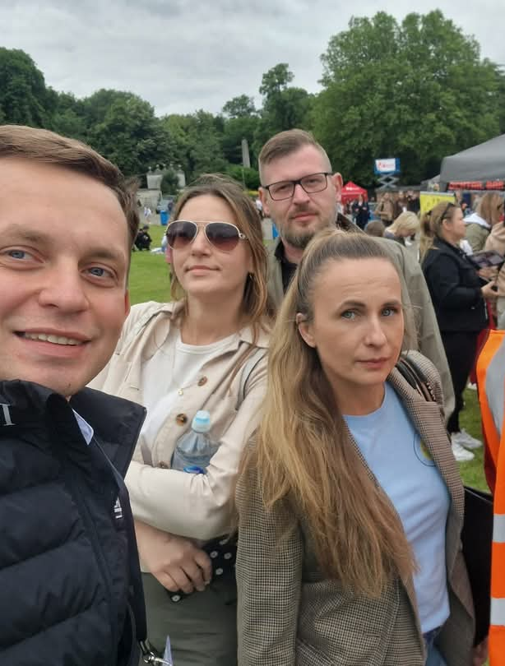
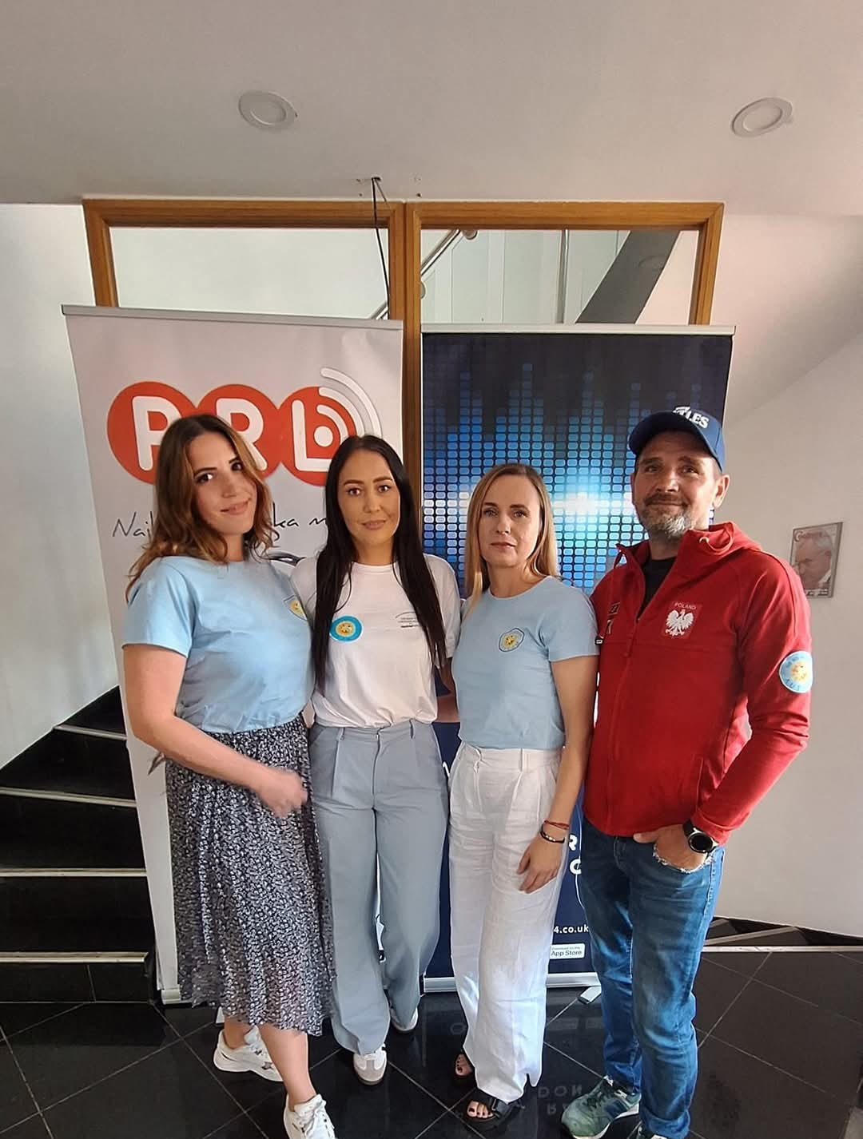
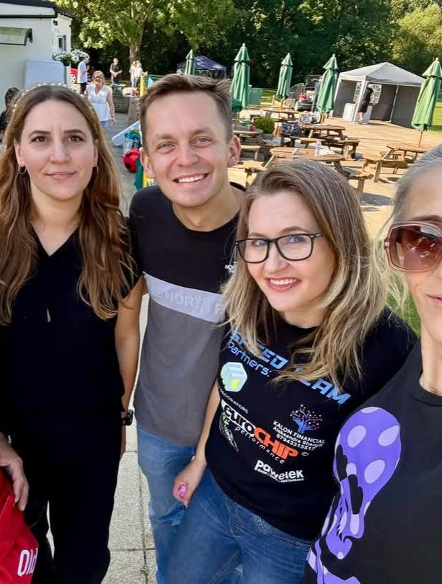
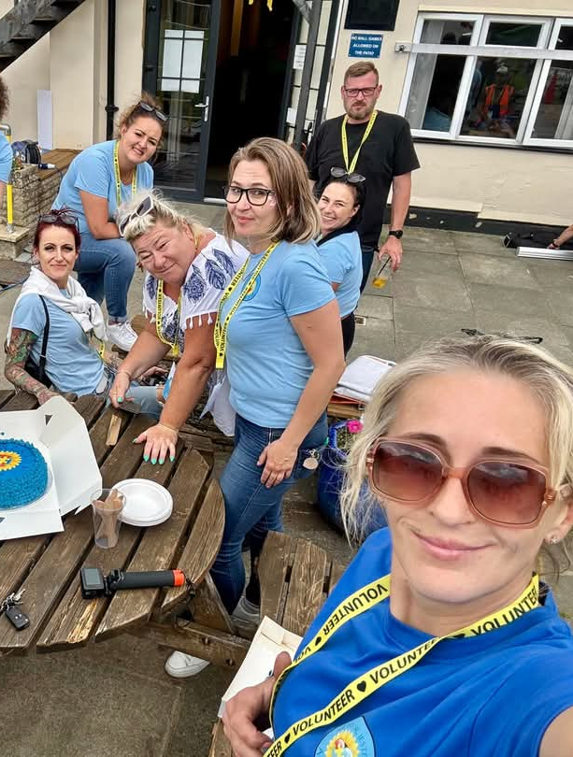
Our Support Team

Slide 4
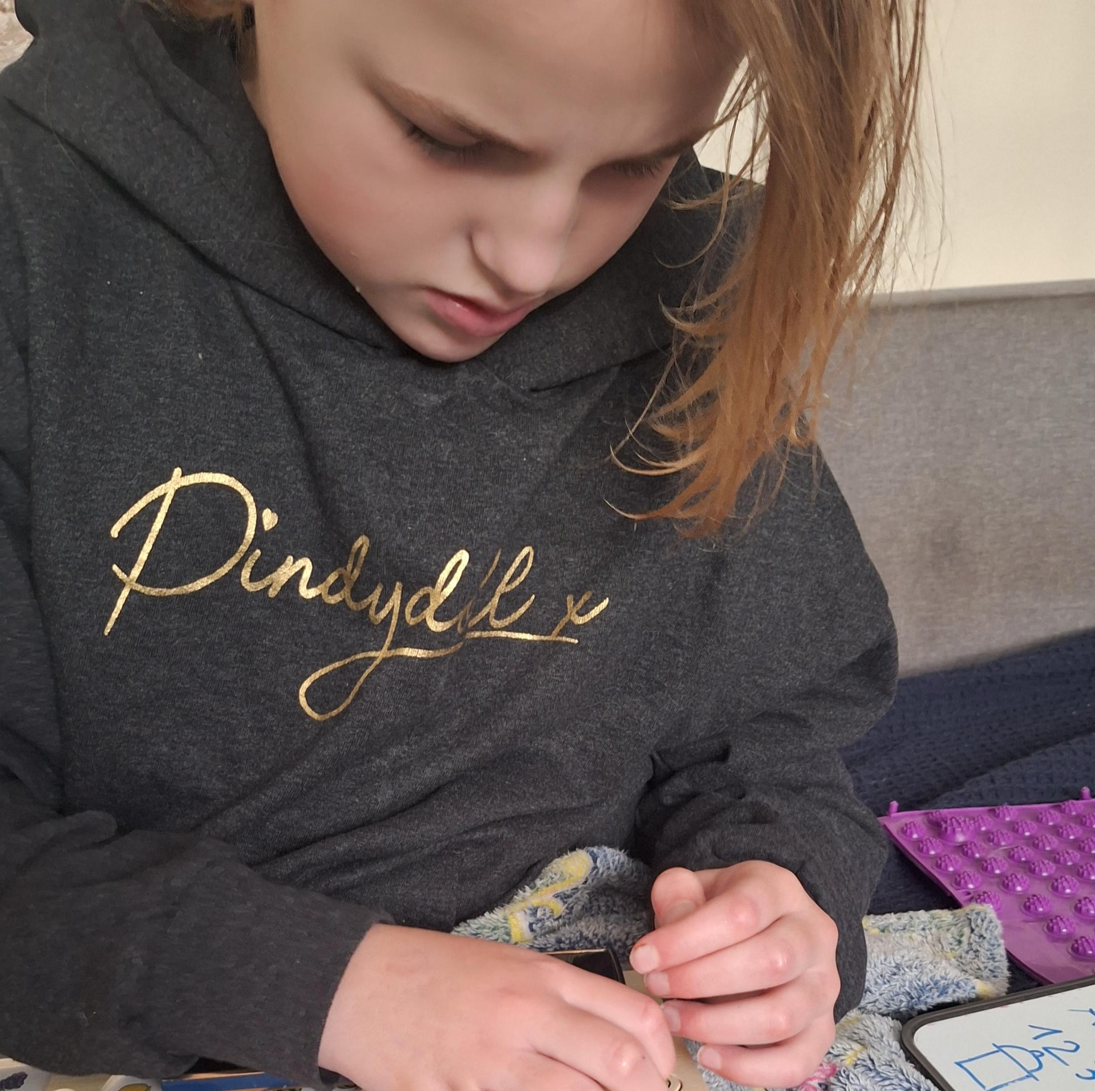
Our Goals:
Organizing free activities and events for children with SEN.
Providing support in handling challenging parenting situations.
Offering guidance on available support and therapy options in daily life.

Slide 5

Our Activities
What do we do?
Workshops and meetings: Parent education, experience sharing, and therapeutic support.
Integration events: Picnics, holiday celebrations, and themed gatherings.
Activities for children: Group and individual therapies tailored to SEN needs.
Informational support: Guidance on where to find help and how to handle challenging situations.

Slide 6
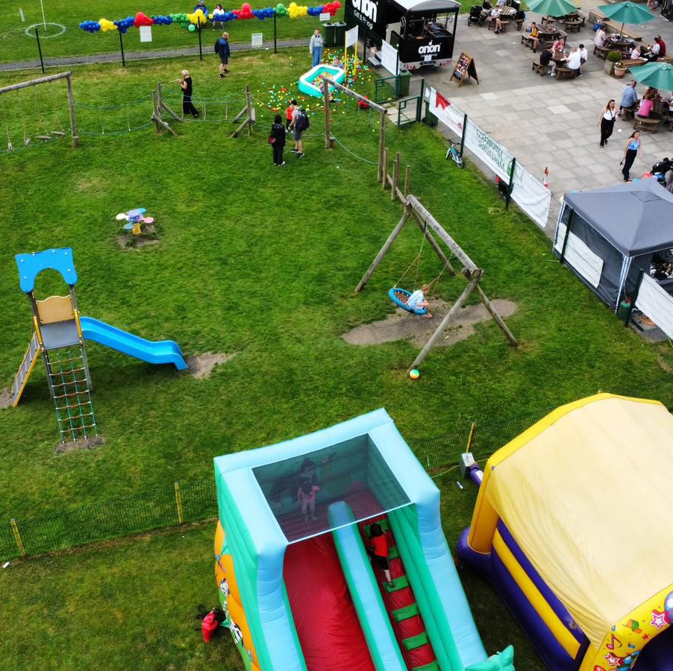
Our Achievements
Summer Picnic 2024: We brought families together in an atmosphere of shared fun.
Themed Workshops: We provided parents with knowledge about autism and ways to support their children.
Christmas Party: We organized tree decorating, gifts, and activities for children.
Carnival Party: More and more people are benefiting from our initiatives. Sensory Integration always has to be on the first place.

Slide 7
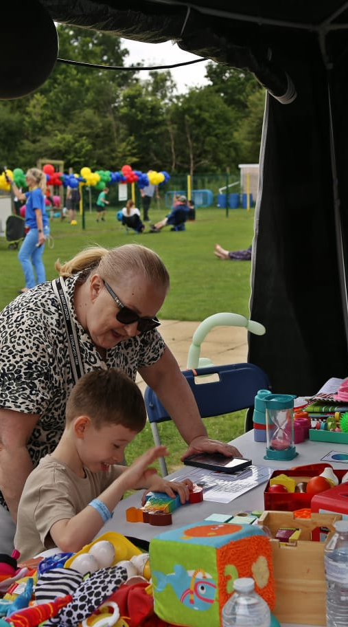
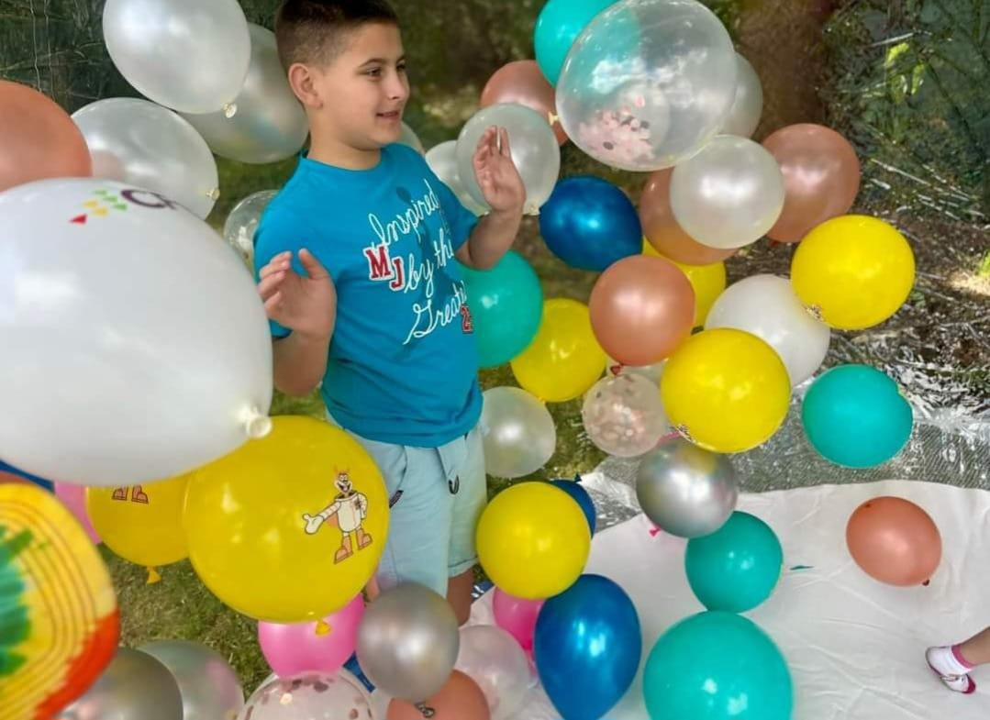
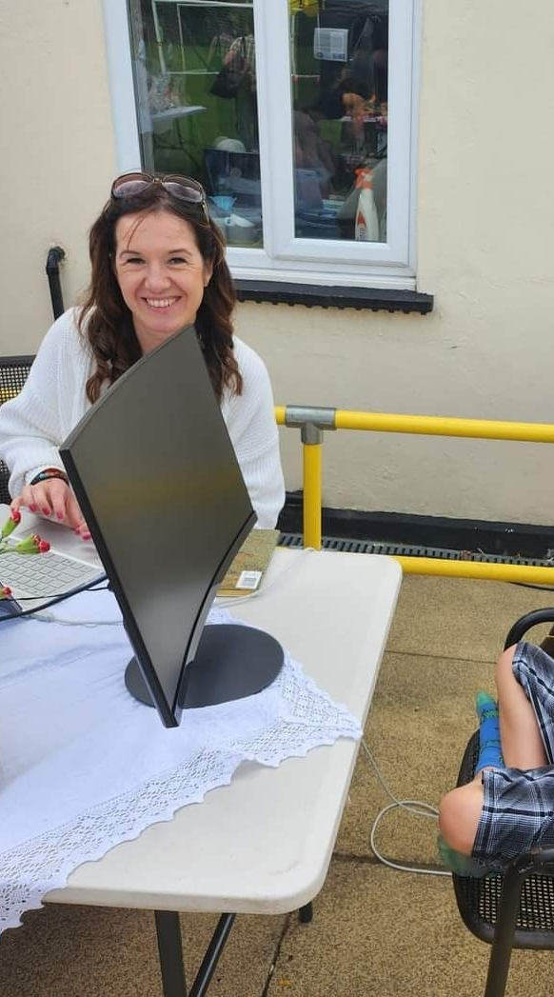
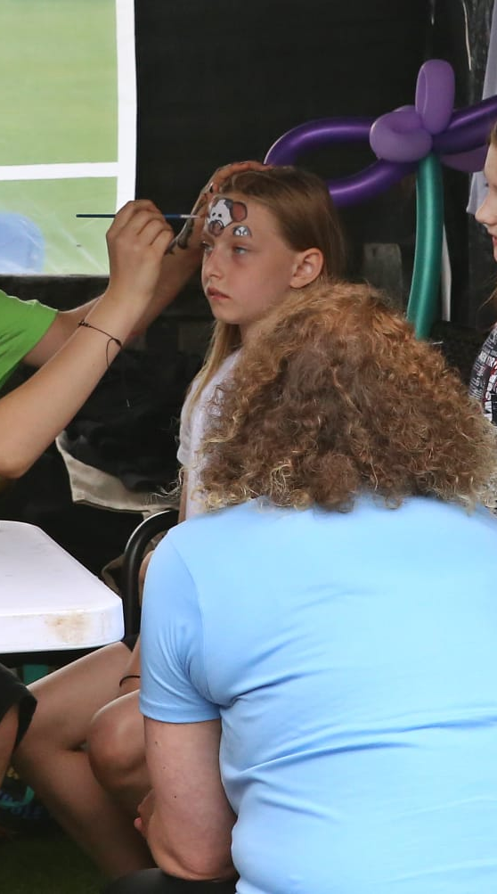
Summer Picnic 2024

Slide 8
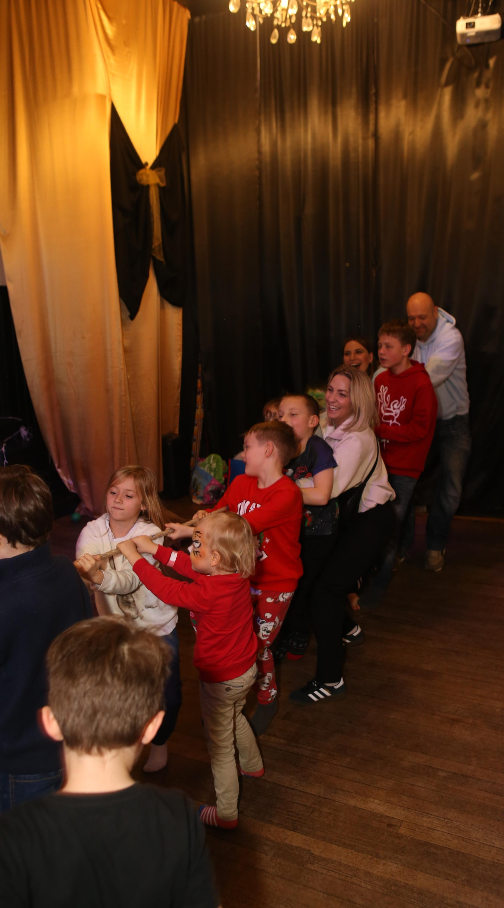
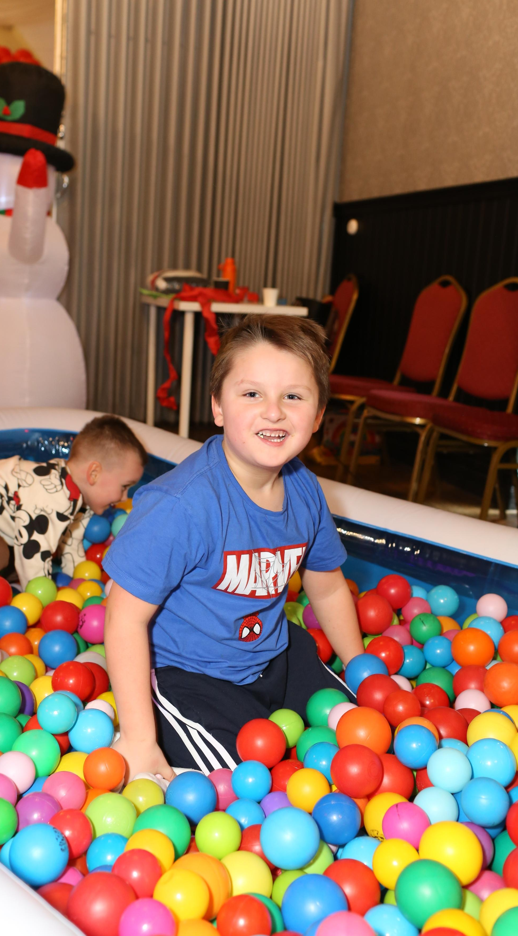
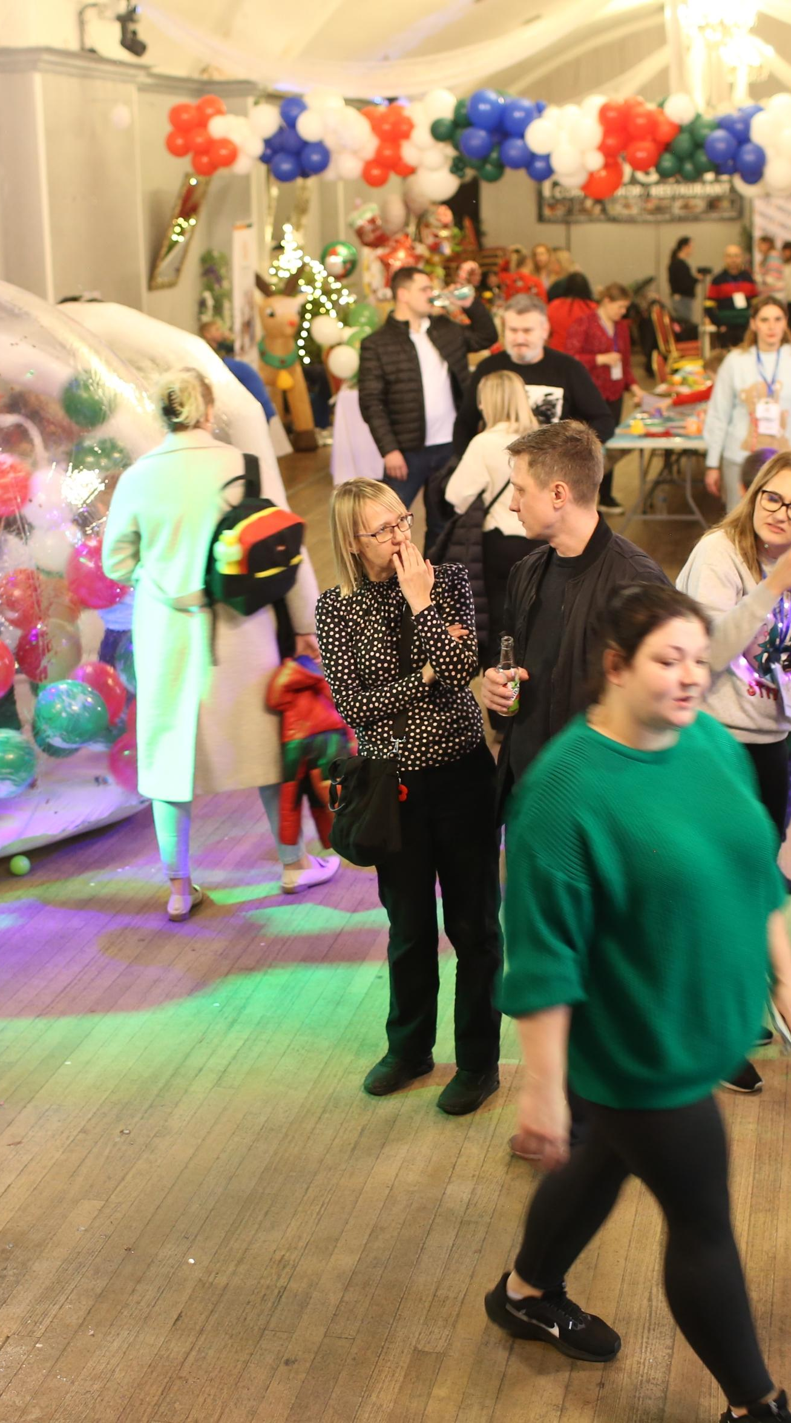
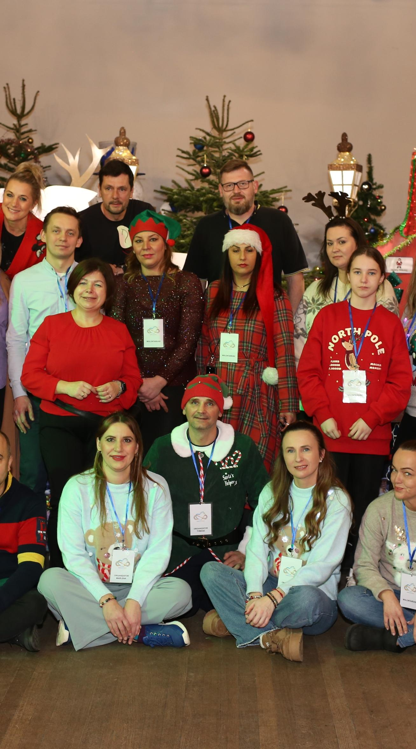
Christmas Party

Slide 9
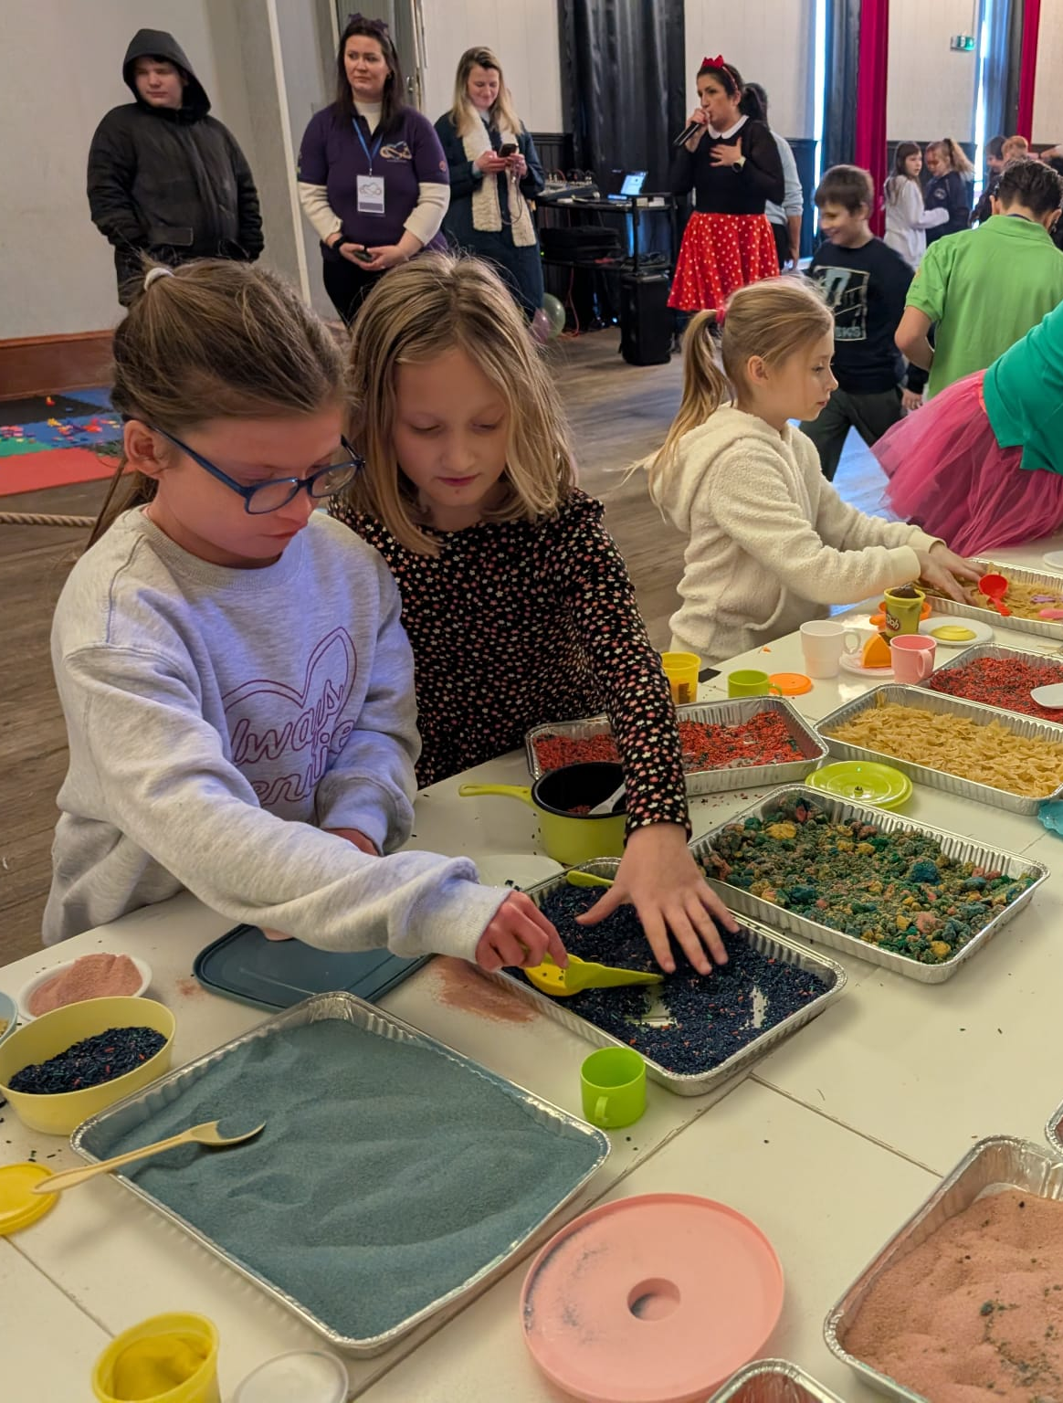
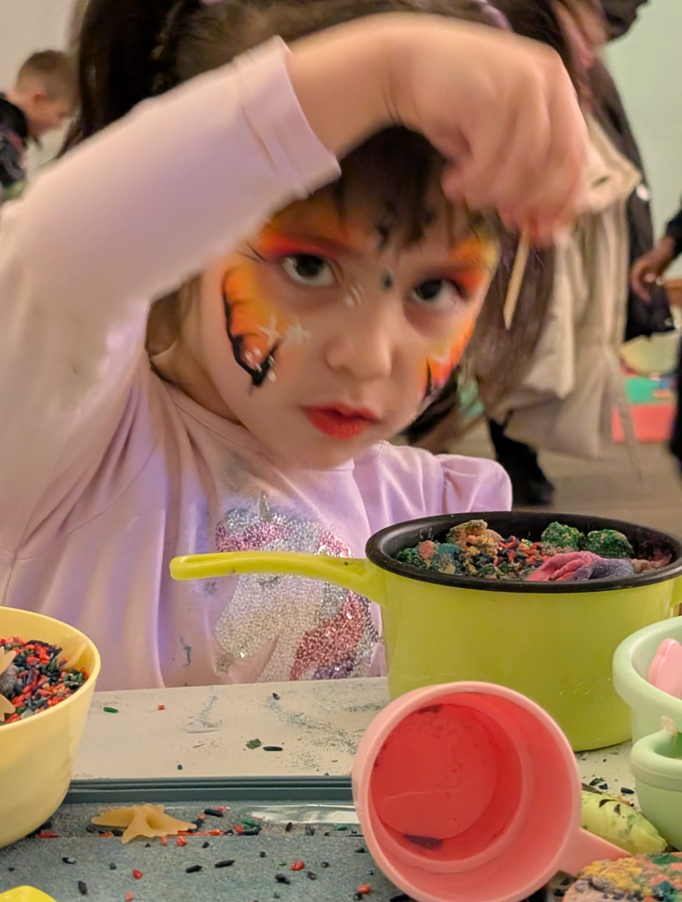
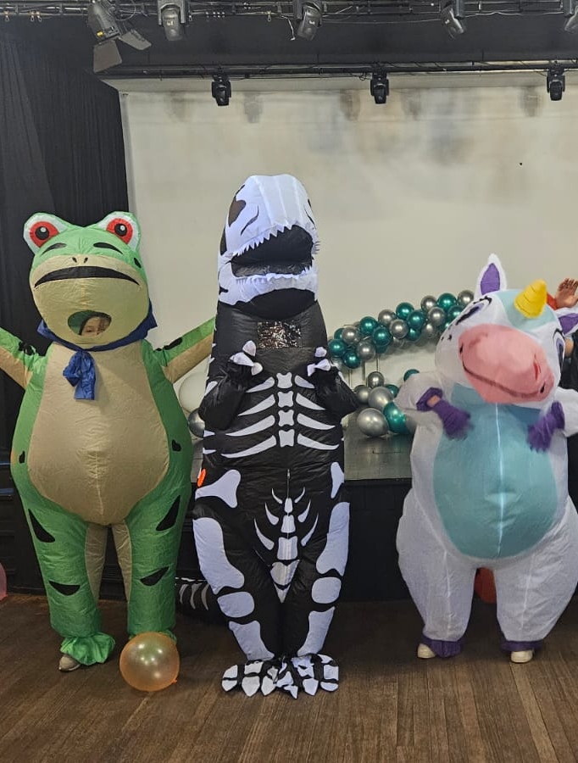
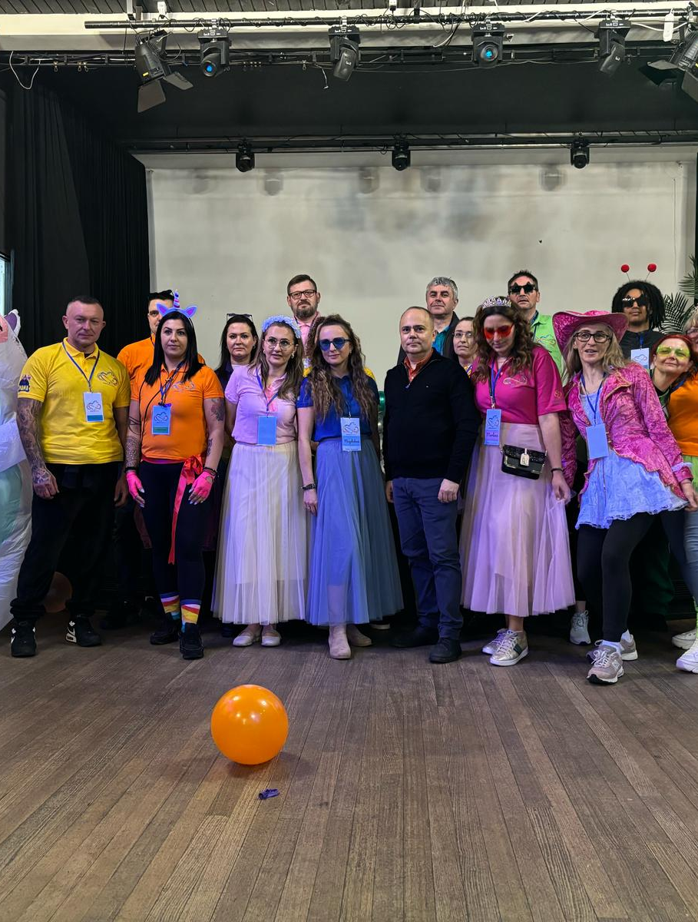
Carnival Party 16.02.2025

Slide 10
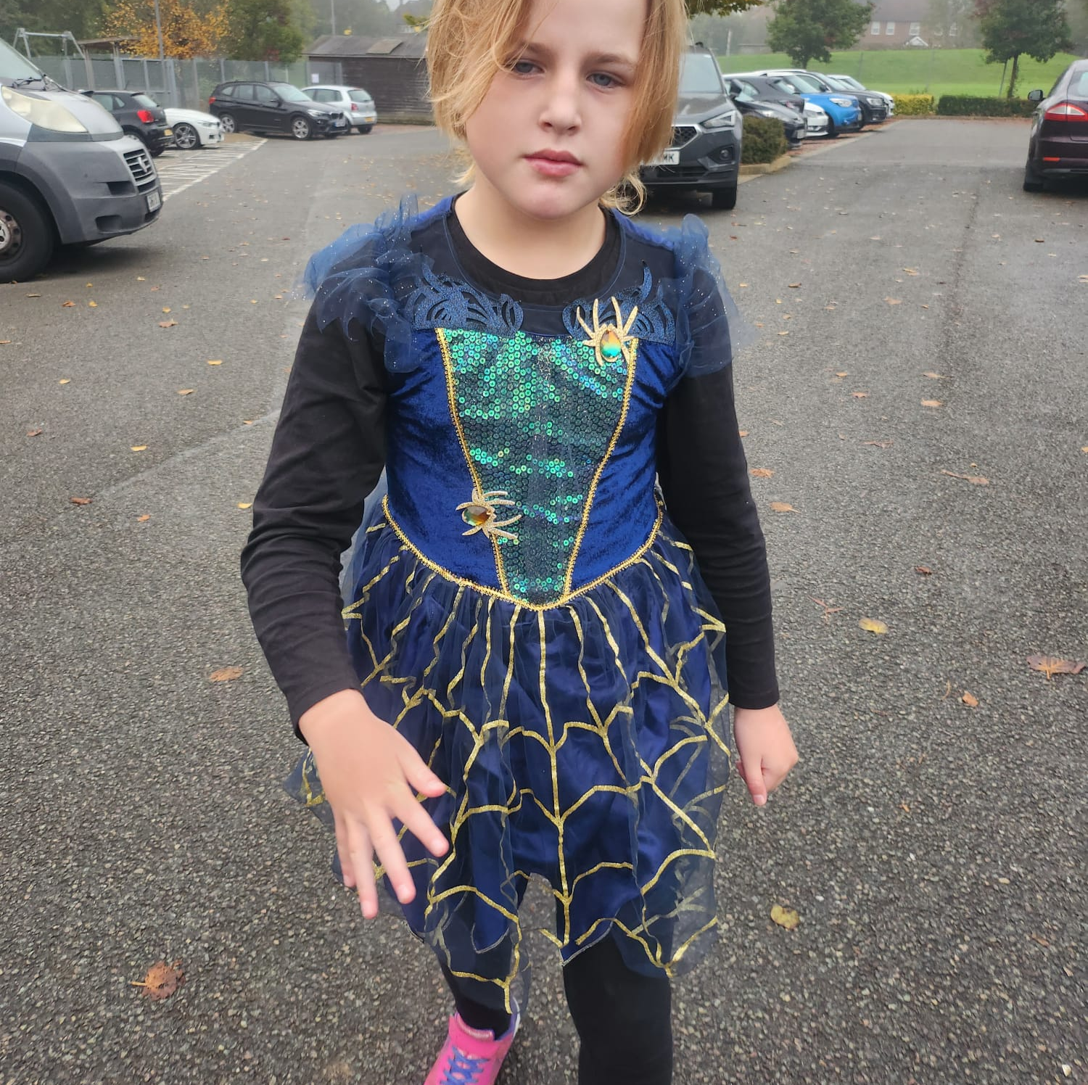
Upcoming
Events 2025
World Autism Awareness Day
Summer Picnic

Slide 11

Work in progress ...

Slide 12

Why Support Us?
We help children with SEN find joy in learning and integration.
We provide parents with tools to better understand their children.
We create a safe space where everyone is accepted.
Collaborating with us is an investment in the future of children.

Slide 13
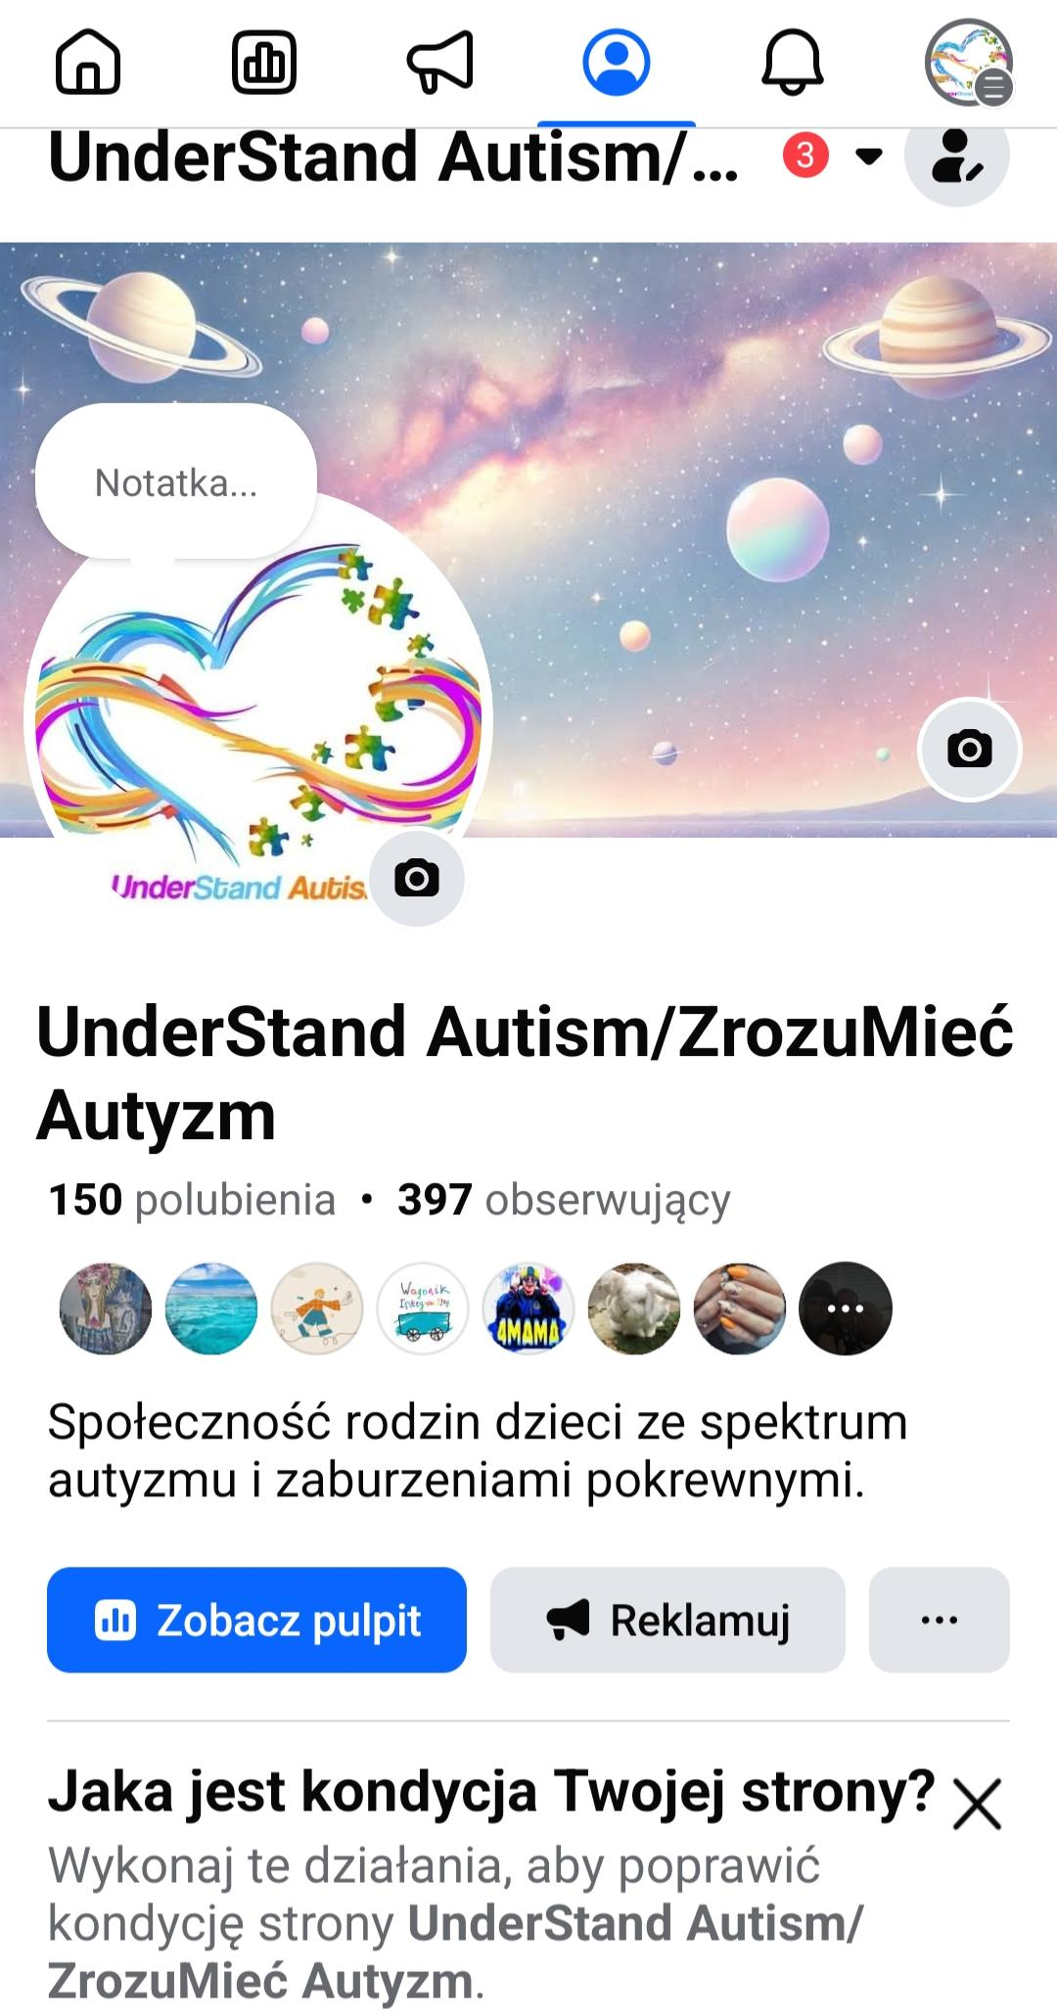
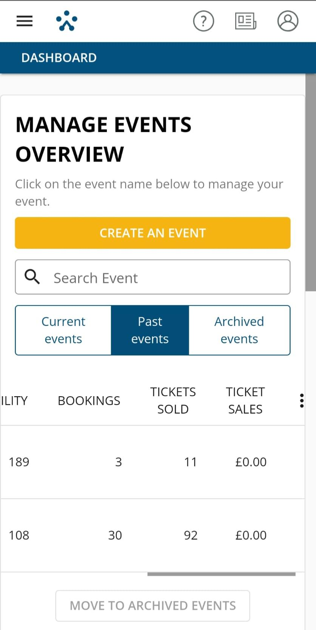
Our Followers
Perticipations
Picnic: More than 200
people attended.
Christmas Party: Over 90
children, along with their
families and friends,
participated in our most
recent event.

Slide 14
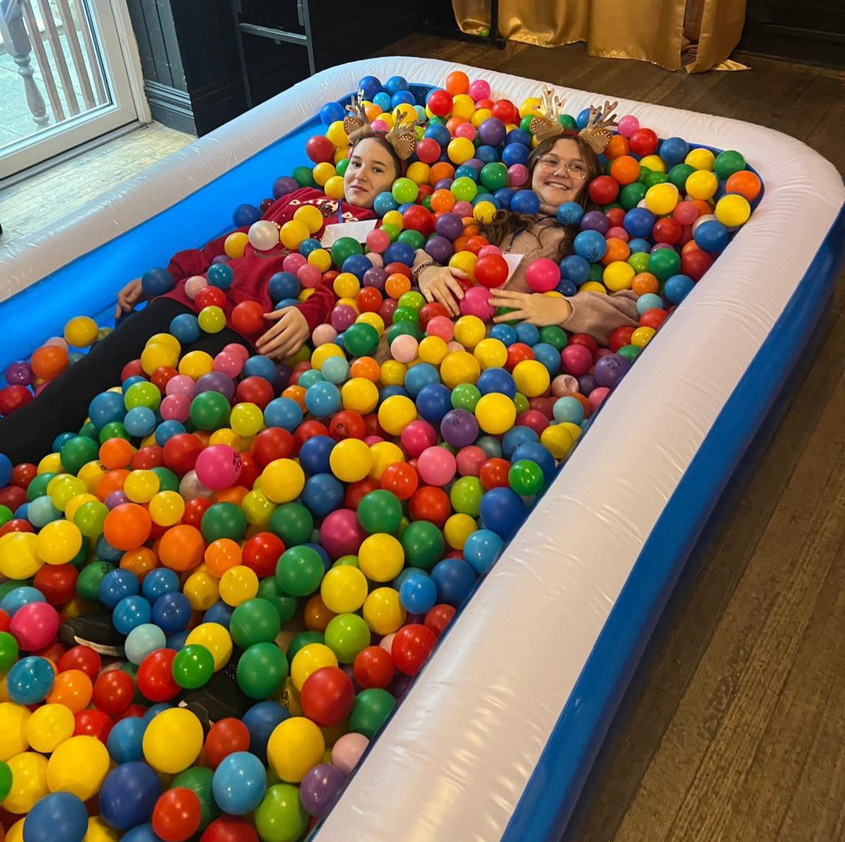
How You
Can Help?
Financial Support: Assistance for renting venues and organizing events such as the Picnic, Christmas Party, or Carnival Ball.
Volunteering: Helping with activities and organizing meetings.
Partnership: Collaborating with companies and organizations interested in supporting the SEN community.

Slide 15
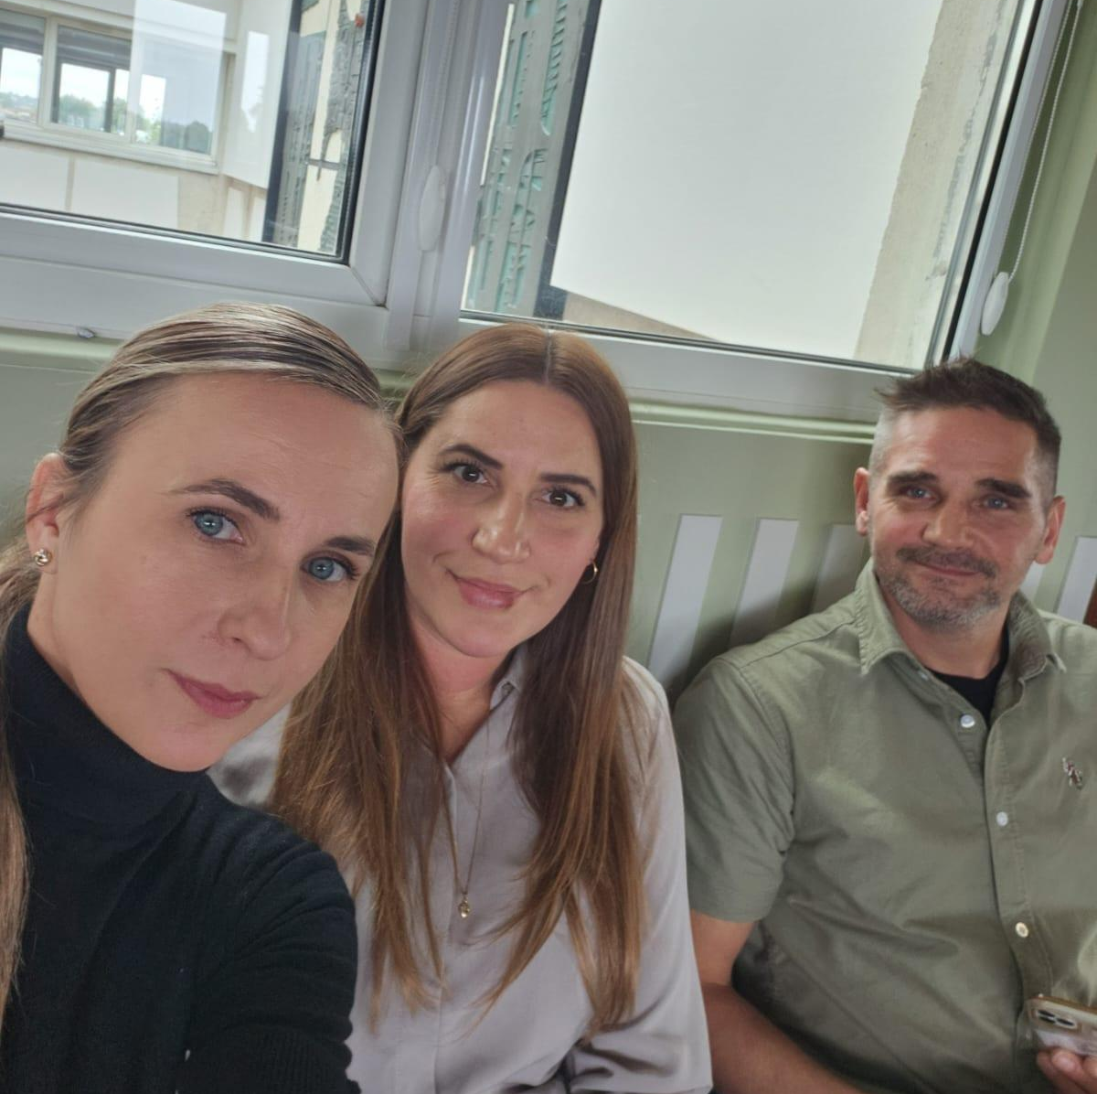

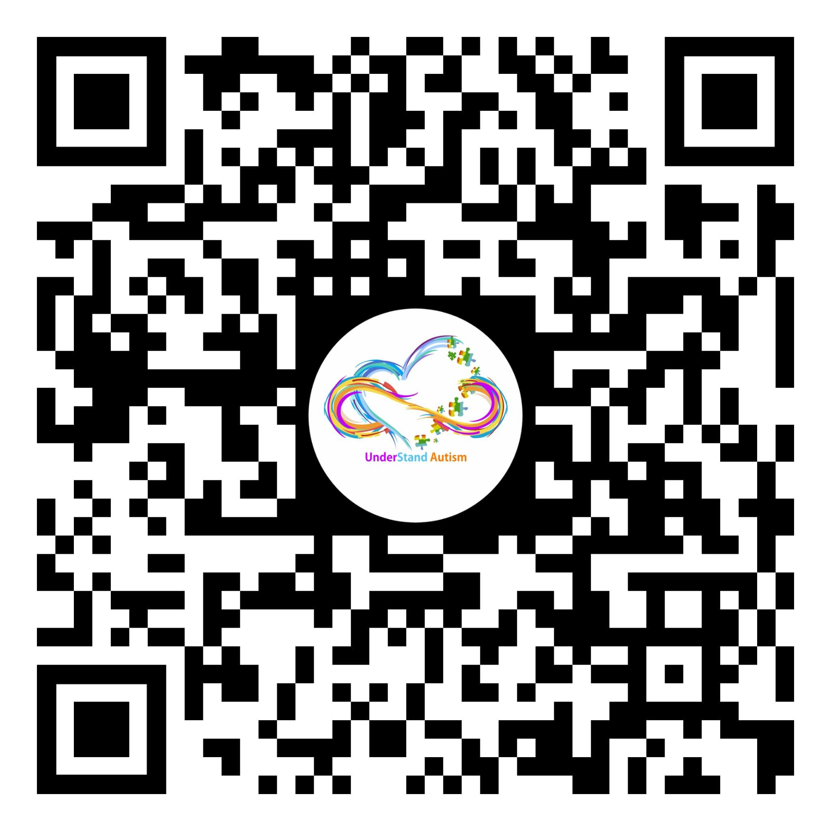
Thank You!
Thank you for your interest in our initiative.
Together, we can make a positive difference in children’s lives!
Feel free to contact us:
📧 Understand.autism.club@gmail.com
📞 +447472855255
💰 Sort Code: 309950
Account Number: 63513063
UnderStand Autism
Facebook

